Slide 1
Delivering a MORE
Effective Presentation
William Kelly, MD FCCP
William.kelly@usuhs.edu

Slide 2

What feedback would you give?!
https://www.youtube.com/watch?v=ATfY8dvbuFg

Slide 3
Overview
Do’s and Don’ts
Making lectures “active”
Tips for presentation slides
Delivery of your lecture*

Slide 4
Large Group Didactics
Advantages
Exposes learner to new material
Instructor sets goals
Complement and clarify material
Efficient communication
Disadvantages
Learners passive
One-way communication
Relies on instructor speaking skills

Slide 5
Definition – Active Learning
“The process of having students engage in some activity that forces them to reflect upon ideas and how they are using ideas”
Adv Physiol Educ. 2006; 30:159-167
J Engineering Education 2004; 93(3), 223-231
Adv Physiol Educ. 2013; 37:347-355

Slide 6
How compelling to YOU is the evidence for “active teaching”?
Very Strong
Strong
Neutral
Weak
What evidence!?

Slide 7
Pause Procedure
45 min lecture to education undergrads
2 min pauses q 15 min
During pause:
  students clarify notes w/ each other
  reflected
Control = traditional lecture (no pause)
Ruhl et al , Teacher Educ and Special Ed 1987; 10: 14-18.

Slide 8
An Engaging Pause is Better
Score
Adapted from Teacher Ed and Special Ed 1987; 10:14-18

Slide 9
Engaging Lectures Are Better
>1000 US college physics students
New engaging instruction vs old traditional
Performance on comprehension
  Force and Motion Conceptual Evaluation
Laws, P et al, UniServe Science News, Vol. 13, July 1999

Slide 10
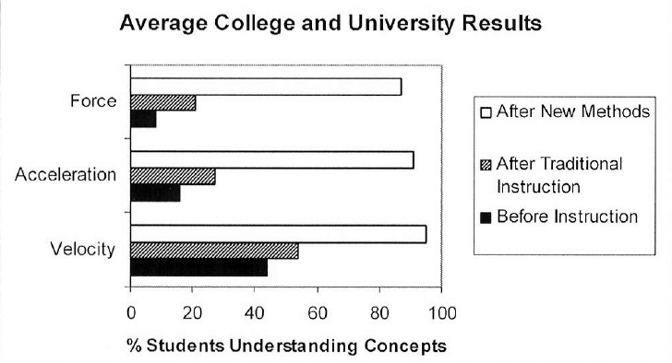
Figure from Journal Engineering Educ 2004, 93(3), 223-231
Laws et al, Uniserve Science News 1999, vol. 13

Slide 11
In a 50-minute lecture, WHEN should you start your 10-minute engaging activity?
Within the first 5 minutes
At 15 minute mark
At 35 minute mark
At 40 minute mark
Any of the above

Slide 12
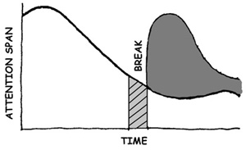
No souls saved after 20 minutes

Slide 13
Primacy-Recency Effect
Adults: 15 min threshold
60 min memory:
  first >> dead last > middle
Danger is the middle of a talk
How the Brain Learns 2011, pages 128-131
Programmed Learning & Educ Techn; 1978; 15; 207-224

Slide 14
Recommended practices for PowerPoint slides include:
Red/Green to emphasize “bad/good” items
“9x9” rule (<9 lines/slide, 9 words/line)
Serif text for slides, sans serif for handouts
Slide display time ~ one minute
Use actual tables from cited journal articles

Slide 15

Poor font, size, color choices

Slide 16
Too Much Writing
Most of the time people write too much
Is it because they feel the need to say something more than needed
  Often it is because- lack of planning
  Rushed in making it – lack of planning
  Cannot find natural break
  Do not want to use separate slides
Some say learners use as a reference
  Could you make more notes outside of the slide to make that information readily available to the learner?
  Reality is- during the presentation, the slide is too busy
  Some cannot read…..what cannot be read cannot be learned
And some read ahead of you and never listen to what you say
And then some things on the slide are just to make the presenter look important
Then you get to the end and you read something like, philosophy, like….teaching is a skill that takes deliberate practice for the rest of your career because teaching is every changing with the changing needs and learning habits of learners everywhere

Slide 17
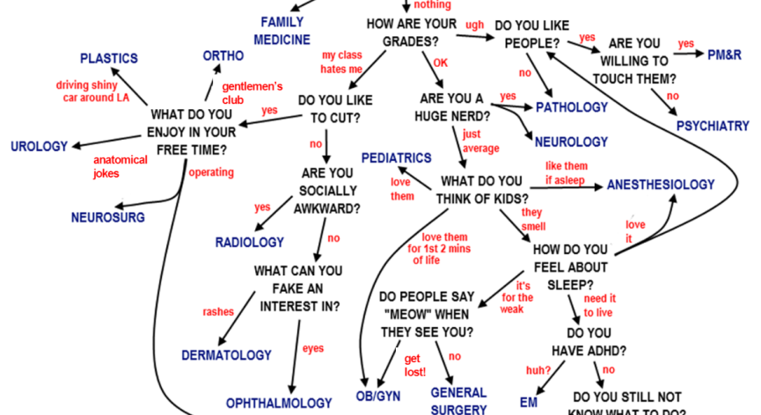
Busy inserts

Slide 18
Preparing and Delivering Effective* Educational Presentations

Slide 19
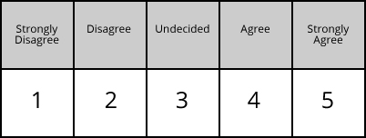

Slide 20
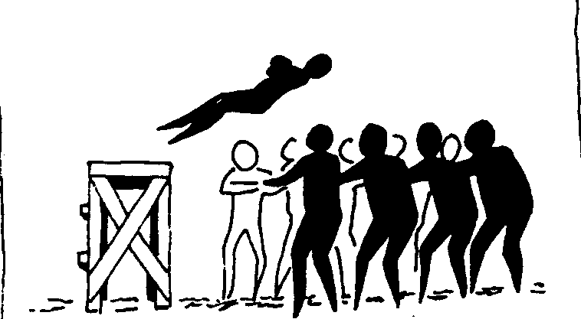

Slide 21



Slide 22
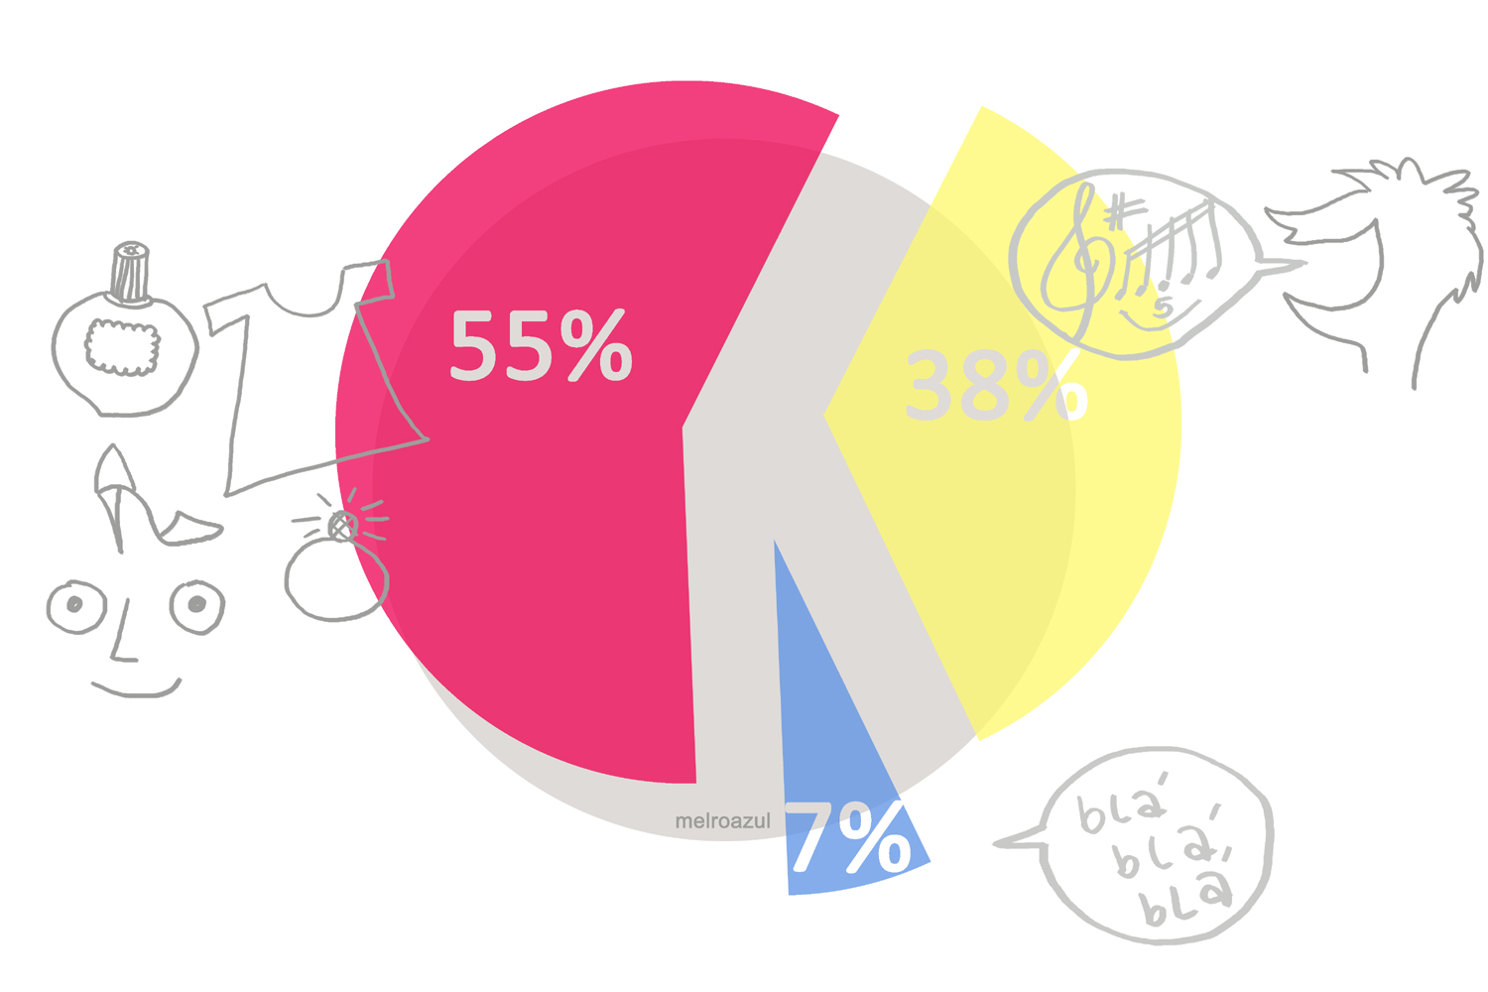
Mehrabian A*
Time
1st impressions

Slide 23
How do medical students form impressions of classroom teacher effectiveness?

Slide 24
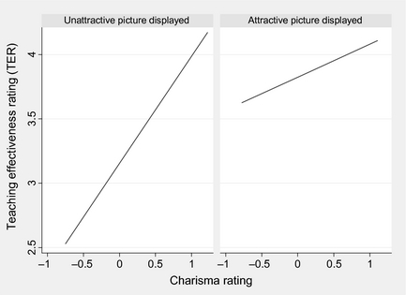
Medical Education 48(8) JUL 2014
Notes:
Relationships among the type of picture displayed, charisma and the audio clip‐based rating of teaching effectiveness
© IF THIS IMAGE HAS BEEN PROVIDED BY OR IS OWNED BY A THIRD PARTY, AS INDICATED IN THE CAPTION LINE, THEN FURTHER PERMISSION MAY BE NEEDED BEFORE ANY FURTHER USE. PLEASE CONTACT WILEY'S PERMISSIONS DEPARTMENT ON PERMISSIONS@WILEY.COM OR USE THE RIGHTSLINK SERVICE BY CLICKING ON THE 'REQUEST PERMISSION' LINK ACCOMPANYING THIS ARTICLE. WILEY OR AUTHOR OWNED IMAGES MAY BE USED FOR NON-COMMERCIAL PURPOSES, SUBJECT TO PROPER CITATION OF THE ARTICLE, AUTHOR, AND PUBLISHER.

Slide 25
S
O
F
T
E
N

Slide 26
Speak up, Square, Strong, Sincere
Open up (hands), observe audience
Forward energy
Talk tone and intensity
Eye contact
Nerves on notice, never apologize

Slide 27
A few more tips…
Video
True simulation
Last minute? Read right to left…
The “Umms”
Hands
Dry mouth
Operant conditioning

